Slide 1


Online Retail Data Analysis
Ghaida alasman

Slide 2
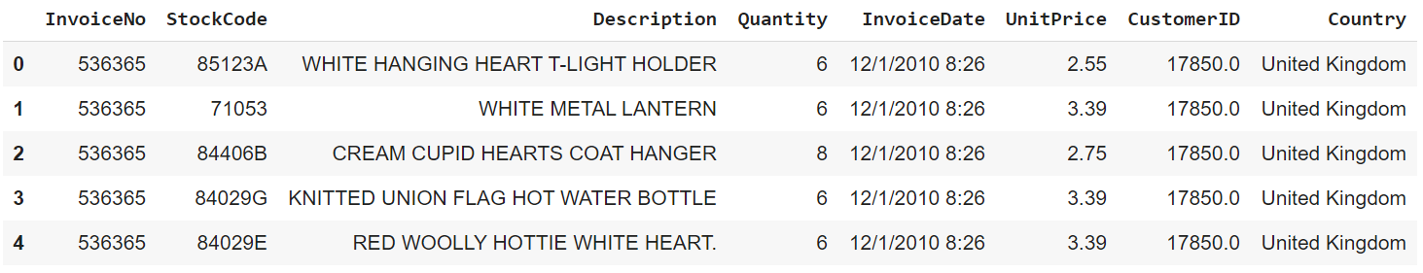
Dataset

Slide 3
Dataset
I am going to:
Explore, clean, and prepare the data using EDA
Visualize the data using Plotly, Matplotlib, and Seaborn to have the answers to some business questions
Classify the customers based on their buying behavior using K-Means clustering

Slide 4
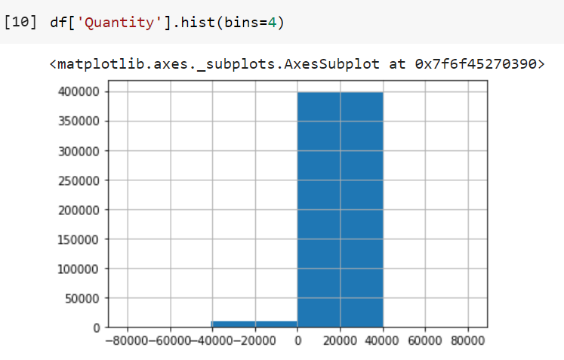
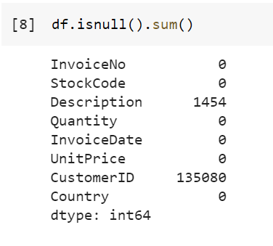
Exploratory Data Analysis (EDA)
Removing missing values
Removing negative values

Slide 5
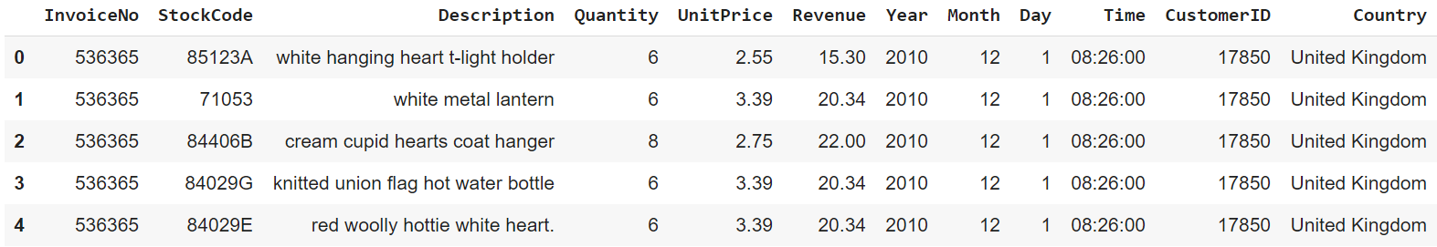
Exploratory Data Analysis (EDA)
Modifying the data types of the columns
Adding new columns

Slide 6
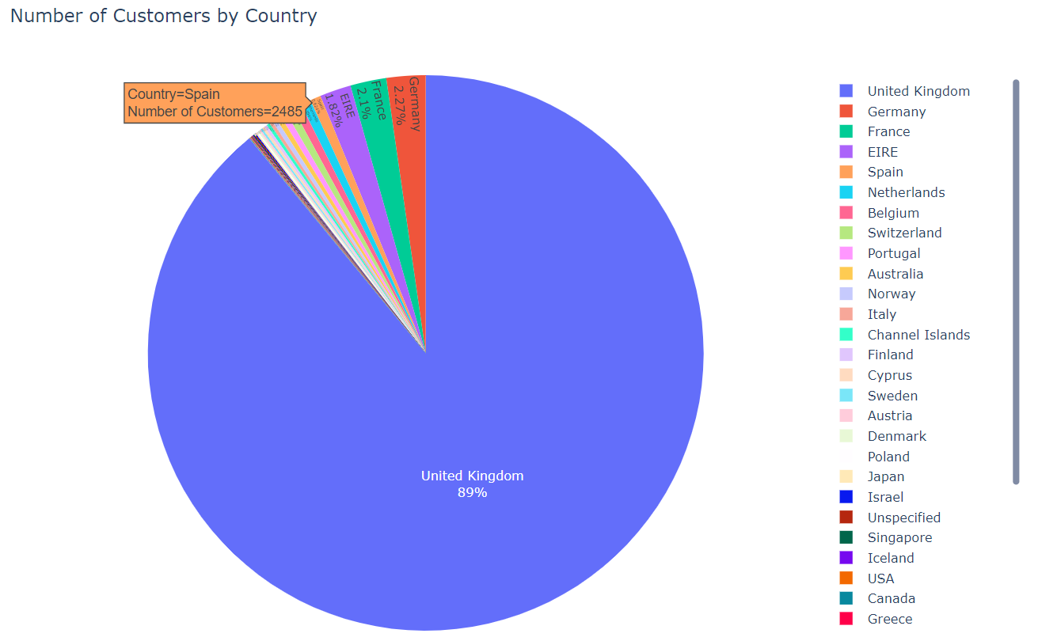
Data Visualization
How many customers do we have in each country?

Slide 7
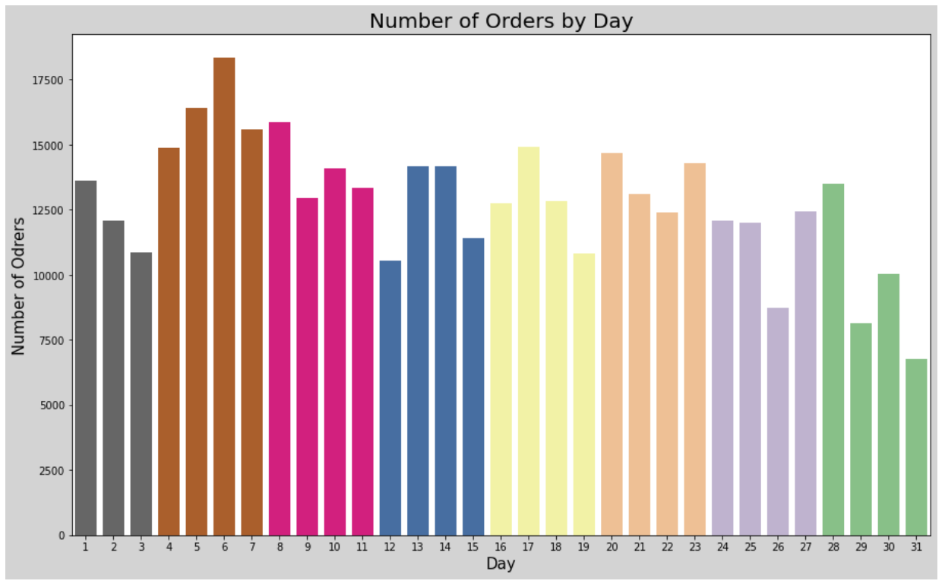
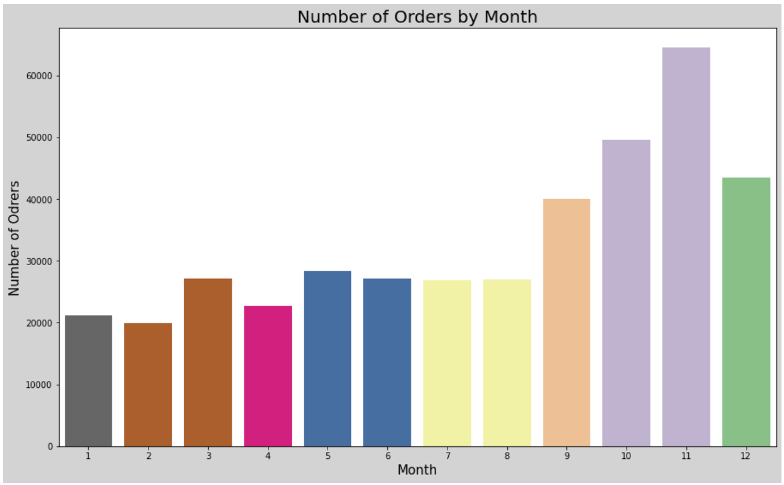
Data Visualization
How many orders do we receive per day and per month?

Slide 8
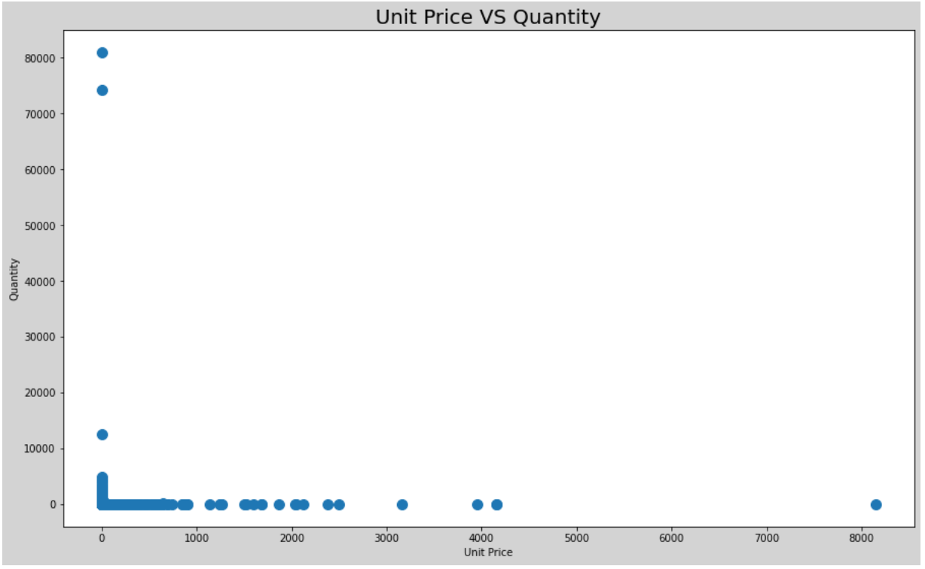
Data Visualization
What is the relationship between the number of units sold and the unit price?

Slide 9
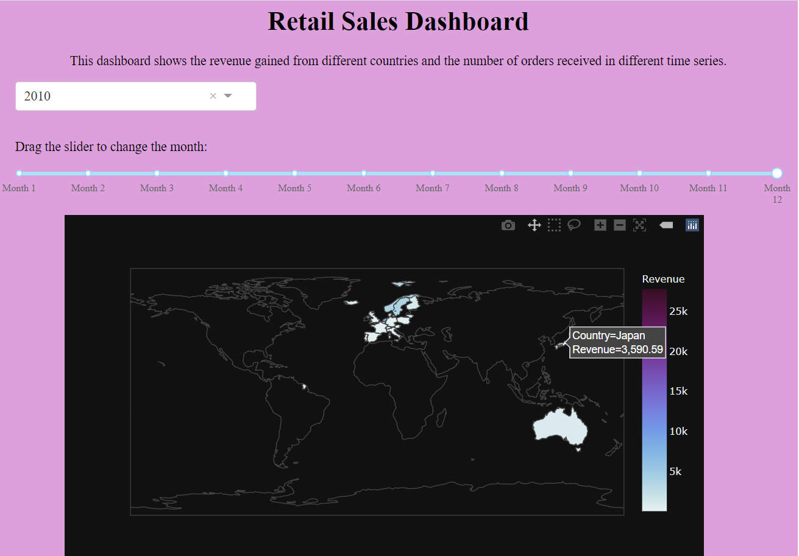
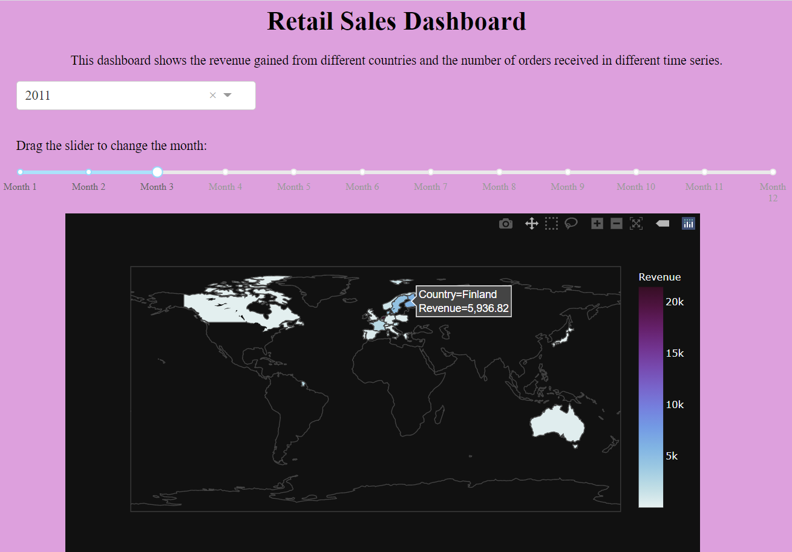
Data Visualization
I used the dash app to create an interactive dashboard that shows the revenue gained and the number of orders received from different countries in different time series.

Slide 10
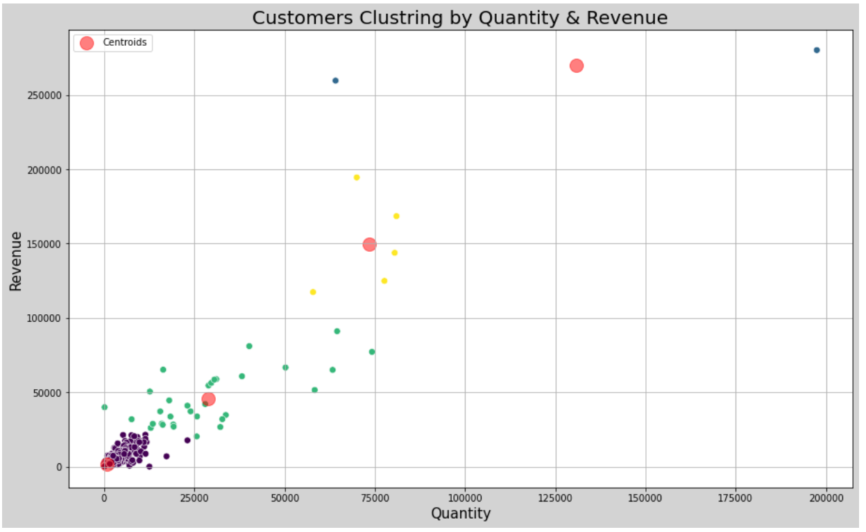
Customer Classification
I used K-Means Clustering to create four clusters of customers based on their purchasing behavior

Slide 11
Thank you for listening
Ghaida alasman

